Slide 1
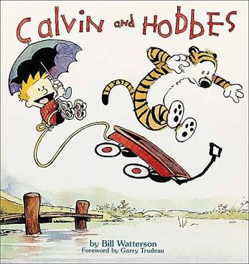
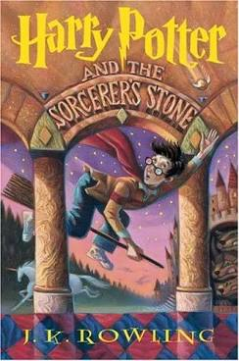


Book Recommender
Johann D’Souza
https://www.linkedin.com/in/johann-dsouza/
https://github.com/dsouzaj98

Slide 2
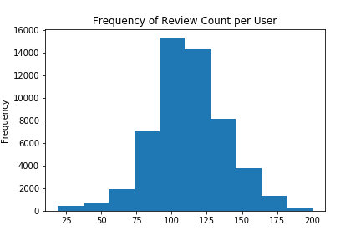
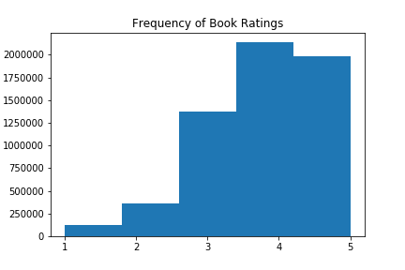
Exploration
The goodbooks dataset from Kaggle contained 10,000 books with approximately 6 million individual ratings given by 53,424 unique users
Ratings were given on a scale of 1 (worst) - 5 (best)

Slide 3
Starting to Model
The objective of this recommender is to recommend books that a person has not read
I found that the average user’s rating was around 3.89
This value will be my benchmark performance for the model

Slide 4
Implementing KMeans
Cluster 1 - Mean: 3.88078
It's a Magical World: A Calvin and Hobbes Collection 4.823529
The Harry Potter Collection 1-4 (Harry Potter, #1-4) 4.815789
Fool's Fate (Tawny Man, #3) 4.785714
The Kindly Ones (The Sandman #9) 4.777778
Brief Lives (The Sandman #7) 4.777778
Harry Potter Boxset (Harry Potter, #1-7) 4.770270
Nothing to Envy: Ordinary Lives in North Korea 4.769231
Cluster 2 - Mean: 3.81556
The Book of Mormon: Another Testament of Jesus Christ 5.000000
Holy Bible: New International Version 4.857143
Fruits Basket, Vol. 1
4.800000
Words of Radiance (The Stormlight Archive, #2) 4.800000
The Cat in the Hat and Other Dr. Seuss Favorites 4.789474
Complete Poems, 1904-1962 4.750000
The Paper Bag Princess 4.750000
Notes:
After testing numerous counts of clusters, I found that the most accurate number of clusters is 7

Slide 5
Testing the model
Recommendation for user 13361: The Harry Potter Collection 1-4 (Harry Potter, #1-4)
Recommendation for user 31159: The Complete Calvin and Hobbes
Recommendation for user 10579: It's a Magical World: A Calvin and Hobbes Collection
Recommendation for user 30375: The Book of Mormon: Another Testament of Jesus Christ

Slide 6
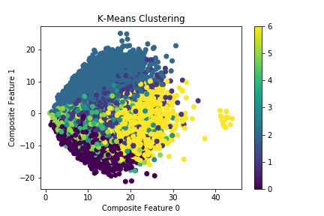

Slide 7
Content based recommender
What if a user does not have a history of ratings? What books should be recommended?
Use a term frequency - inverse document frequency (tf-idf) vectorizer to create a cosine similarity matrix of the names of the authors
I can then use this matrix to find similar authors’ books based on the ratings that were given by other users
Recommendations for ‘The Hobbit’:
The Hobbit or There and Back Again
The Fellowship of the Ring
The Two Towers
The Return of the King
The Lord of the Rings
The Hobbit and The Lord of the Rings
Nikola Tesla: Imagination and the Man That Invented the 20th Century
The Children of Húrin
Entwined
The 7 Habits Of Highly Effective Teens

Slide 8
Improvements for the Future
One issue was that the popular books such as Calvin and Hobbes and Harry Potter dominated the recommendations so removing extremely popular books could give more interesting results
Another way to improve the performance of this model would be to obtain more detailed data that was not restricted to a strict 1-5 rating as well as a standardized meaning for the rating

Slide 9
Thank You!

